Slide 1
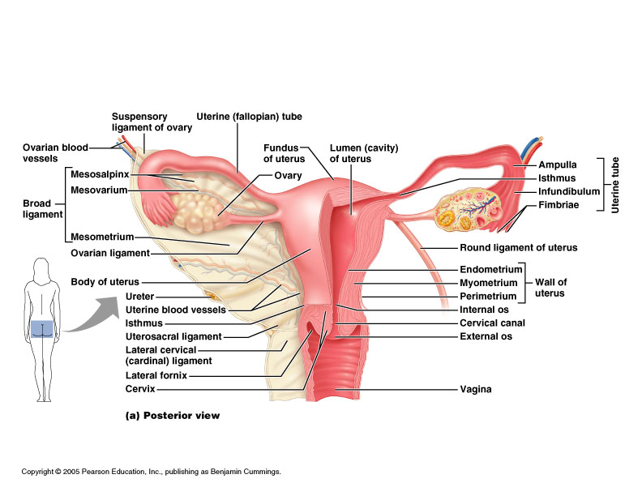
The uterus:
-Pear shaped structure attached to oviducts at upper end and to vagina at lower end.
-Uterine wall has 3 layers:
*Endometrium
*Myometrium
*Serosa or
adventitia

Slide 2
*Endometrium
-composed of simple columnar epithelium invaginated in to simple tubular glands, ciliated columnar cells and secretory columnar cells.
-lamina propria composed of highly cellular connective tissue and vessels.
-two zones in Endometrium:
1-Functinal layer
a thick superficial layer that is sloughed off during menstruation.
Replaced during each menstrual cycle.
Is vascular zed by numerous coiled arteries.

Slide 3
2-Basal layer
A deeper layer, narrow whose glands and connective tissue elements retained after menstruation.
Gland cells give rise to new epithelium.
*Myometrium
-thickest muscular layer wall of the uterus.
-composed of three layers of smooth muscle separated by connective tissue.
-inner and outer layers are mostly longitudinal in orientation.
-middle layers are more circular, thickens in pregnancy with more smooth muscle cells and increased collagen.
-the size and number of the myometrial muscle cell related to estrogen level.

Slide 4
2-Basal layer
A deeper layer, narrow whose glands and connective tissue elements retained after menstruation.
Gland cells give rise to new epithelium.
*Myometrium
-thickest muscular layer wall of the uterus.
-composed of three layers of smooth muscle separated by connective tissue.
-inner and outer layers are mostly longitudinal in orientation.
-middle layers are more circular, thickens in pregnancy with more smooth muscle cells and increased collagen.
-the size and number of the myometrial muscle cell related to estrogen level.

Slide 5
*Serosa or Adventitia
-much of its anterior portion is covered by adventitia consist of connective tissue without an epithelial covering.
-the fundus and posterior portion of the body are covered by a serosa, composed of a layer of squamous mesothelium cells resting on areolar c.t

Slide 6
Uterine cervix
-lower part of uterus.
-lined by mucous secretion simple columnar epithelium.
-some smooth muscle and much connective tissue in lamina propria.
-part of cervix in upper vagina has stratified squamous no keratinized epithelium.
-cervical mucosa has mucous glands.
-less branching no coiled artery, thicker Endometrium and thinner Myometrium.
-cervical mucosa remains intact during menstrual cycle.
-Cervical gland secretions vary during menstrual cycle.
-at ovulation mucous is watery so sperm can penetrate easily, in luteal phase or pregnancy mucous more viscous to block sperm or microbes.

Slide 7
Vagina
-epithelium is stratified squamous partly keratinized.
-no glands in epithelium.
-underlying lamina propria of loose connective tissue, highly vascular zed with many elastic fibers.
-muscular layer of circular and longitudinal smooth muscle.
-adventitia of dense irregular connective tissue with elastic fibers, many vessels and nerves.

